Slide 1
Excel Tips
© McGraw Hill LLC. All rights reserved. No reproduction or distribution without the prior written consent of McGraw Hill LLC.

Slide 2
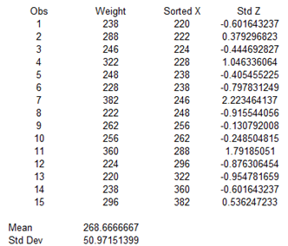
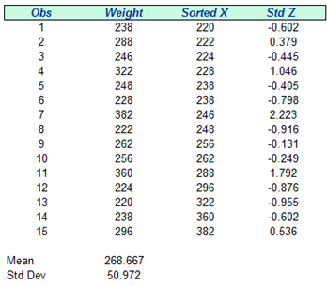
Cell Format
Tip: Adjust font, color, border, and titles to improve readability or to provide emphasis.
Tip: Round to make the numbers easier to read.
Tip: Use same decimal format within each column.

Slide 3
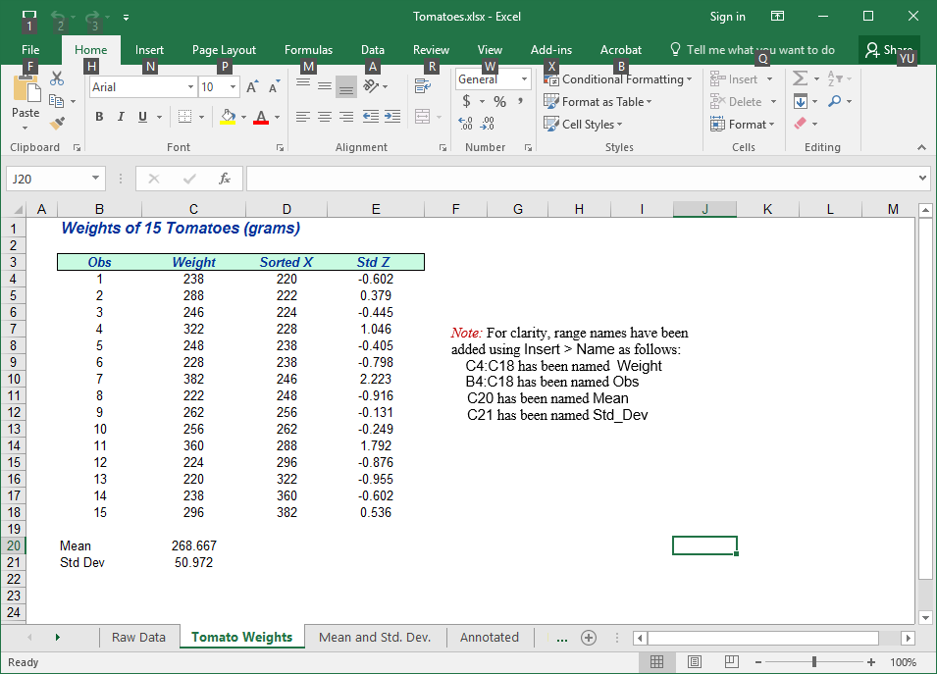
Worksheet Names
Tip: A short, descriptive tab name for each worksheet will help you organize your work. Click on the tab name to edit it.

Slide 4
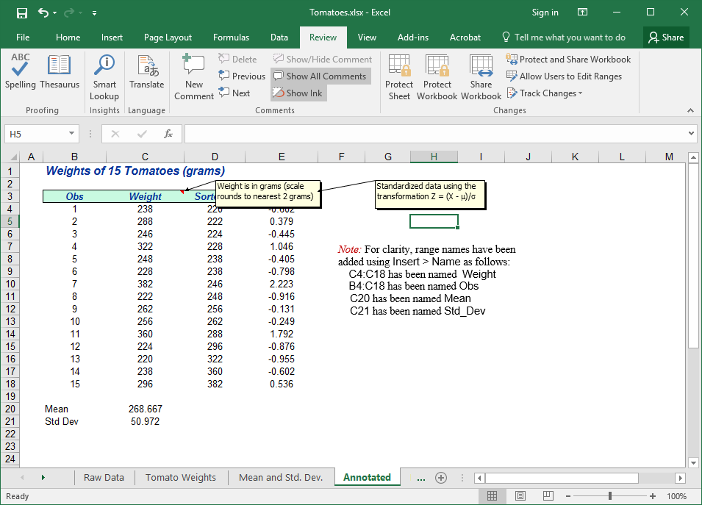
Cell Comments
Tip: Cell comments help you (or others) remember what is in the cells.
Tip: Click Show All to reveal cell comments.

Slide 5
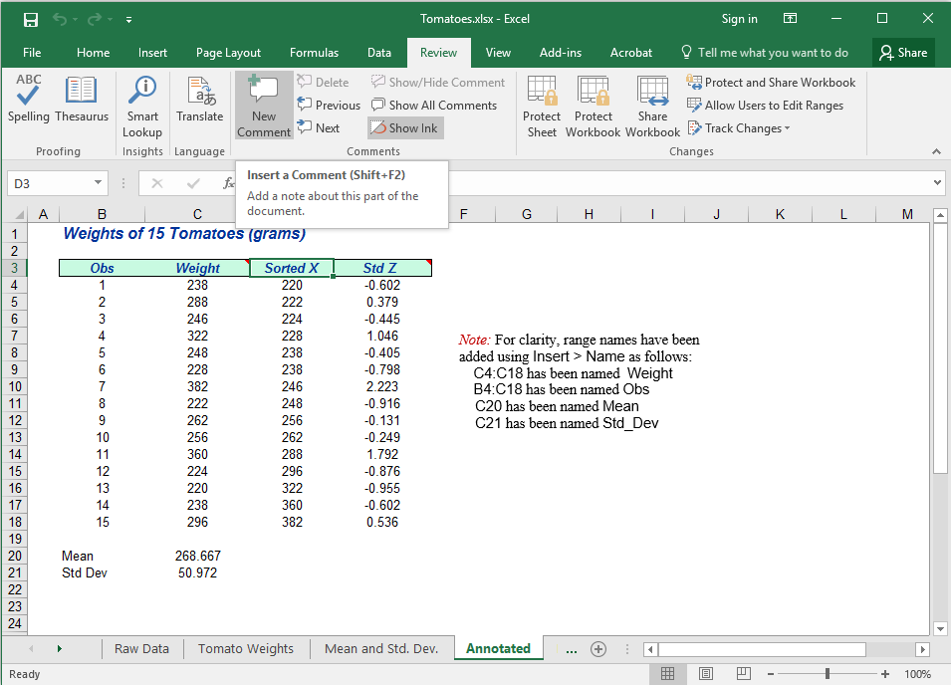
Cell Comments
Tip: Click on the Review tab and then click New Comment.
Tip: Just right-click on a cell and choose Insert Comment.

Slide 6
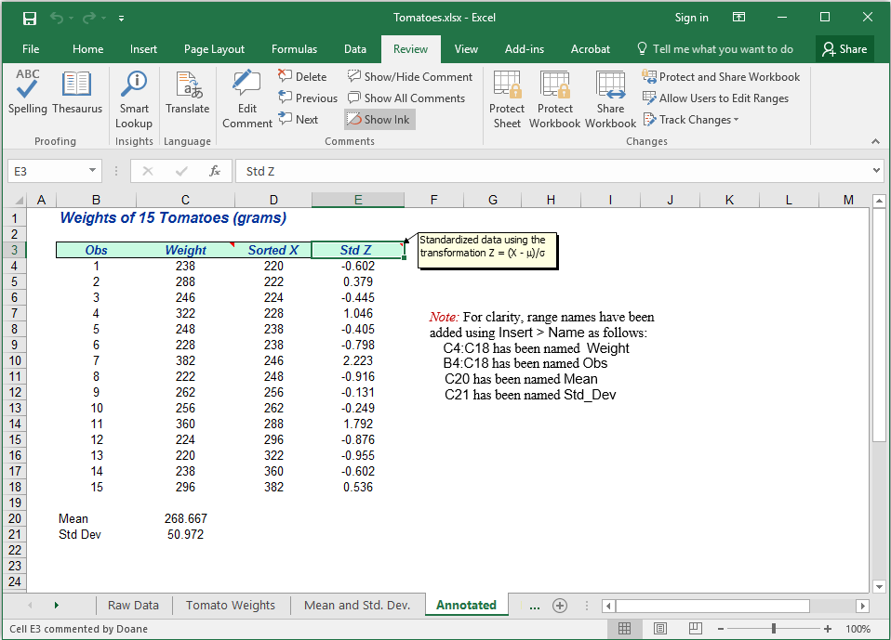
Cell Comments
Tip: A comment may use any font or color. Use Symbol font m and s to get Greek μ and σ.
Tip: To edit a comment, click the Review tab and then click Edit Comment.

Slide 7
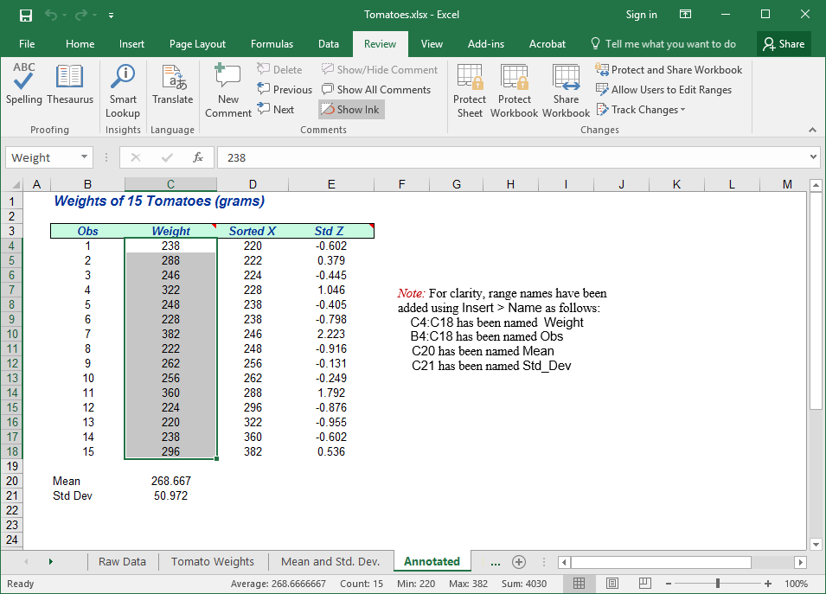
Cell or Range Names
Tip: Are you tired of entering cell ranges like C4:C18? Why not name your data?
Tip: Highlight a cell or range of cells you want to name. Enter name in box at upper left. No spaces are allowed in a name.

Slide 8
Cell or Range Names
Tip: Highlight a data range and type a name in the name box. In this example, we can refer to Weight instead of C4:C18 in any formula that refers to this data range.
Tip: You can also name a single cell (e.g., Mean in cell C20). Avoid illegal names that might be confused with a cell reference (like A3) or a function (like Average).

Slide 9
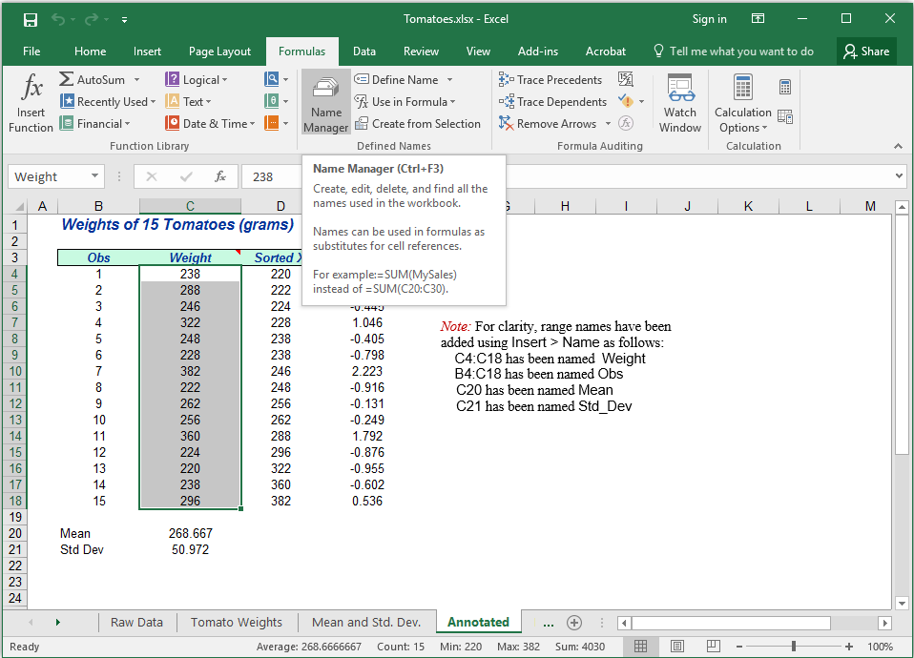
Managing Names
Tip: To see all your range names, click on the Formula tab and select Name Manager. You can delete or edit range names.

Slide 10
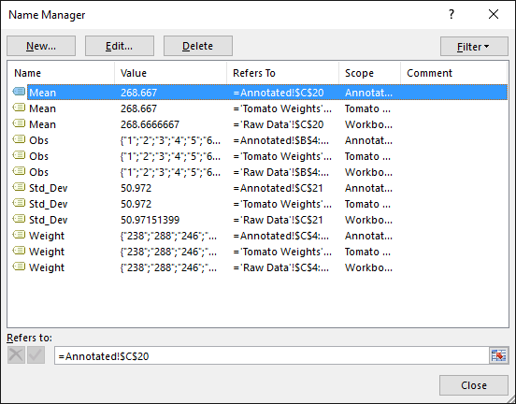
Managing Names
Tip: You can delete or edit your cell or range names.

Slide 11
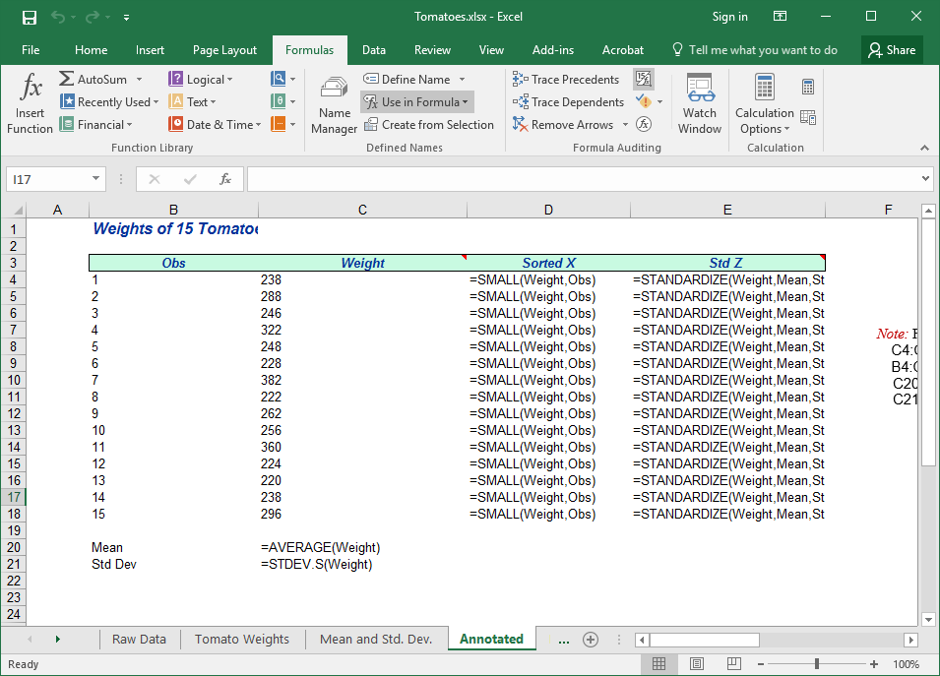
Show Formulas
Tip: You can reveal your cell formulas by entering Ctrl `

Slide 12
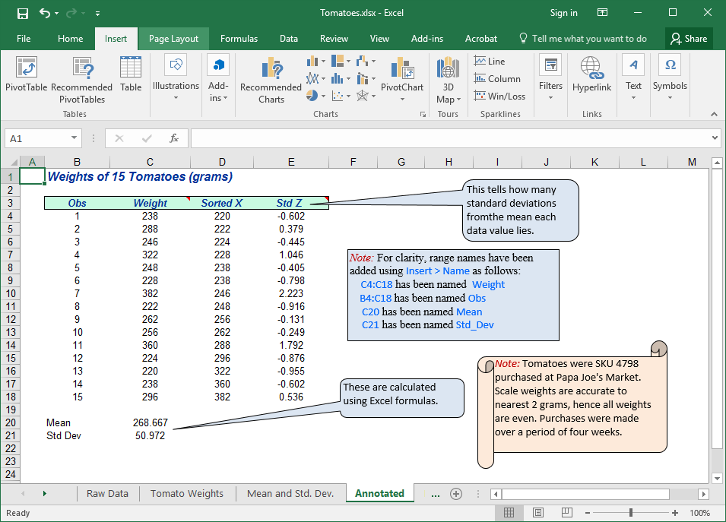
Shapes and Text Boxes
Tip: Explain or call attention to things by inserting a shape, text box, or comment.
Hint: You can edit text to change its color, font, etc.

Slide 13
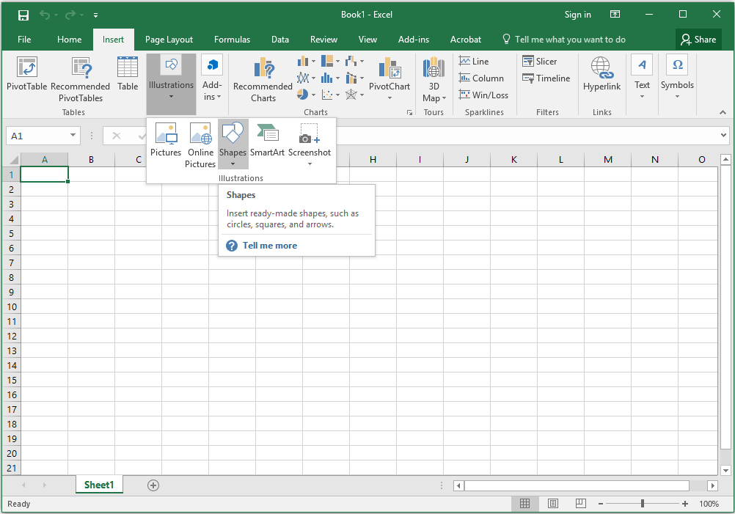
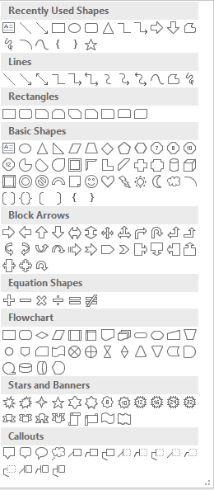
Insert Shapes?
Click Insert and then choose Illustration or Shape. Choose a shape from the menu.

Slide 14
Which Shapes?
Scroll
So many shapes, so little time
Edit shape, text colors, font, etc. Hint: Don’t overdo it!
Star
Sample
Shape
Arrow
Button

